Slide 1
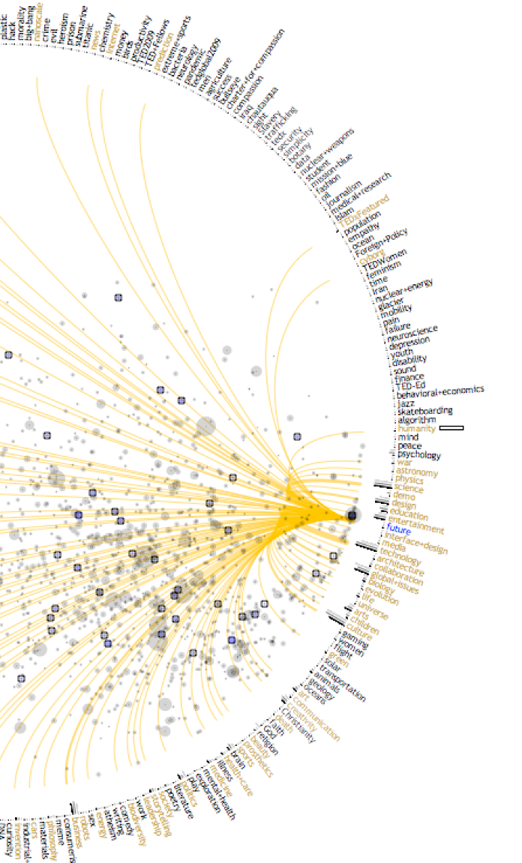
Patterns
A Samuel Pottinger
Stat 198: IDSV
Mar 5, 2025

Slide 2
Today
> Variables: dimensions and measures.
Patterns: a sampling of options in increasing density.
Group activity: choosing a pattern for a problem.
Tasks and domains: a look at contextualizing patterns by understanding users.

Slide 3
What do these terms mean?
Observation
Value
Variable
Dimension
Measure

Slide 4
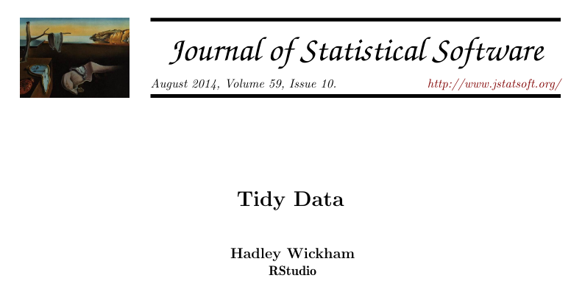
Observations
Variables
The column names.
Values
A value seen inside a cell.
Observations
Rows in a table.
Age | Income | Region
20 | 100,000 | West
31 | 140,000 | East
42 | 160,000 | West

Slide 5

Variables
Dimensions
Variables by which observations are divided or segmented.
Measures
Numeric values which are encoded in visual channels.

Slide 6
Today
Variables: dimensions and measures.
> Patterns: a sampling of options in increasing density.
Group activity: choosing a pattern for a problem.
Tasks and domains: a look at contextualizing patterns by understanding users.

Slide 7
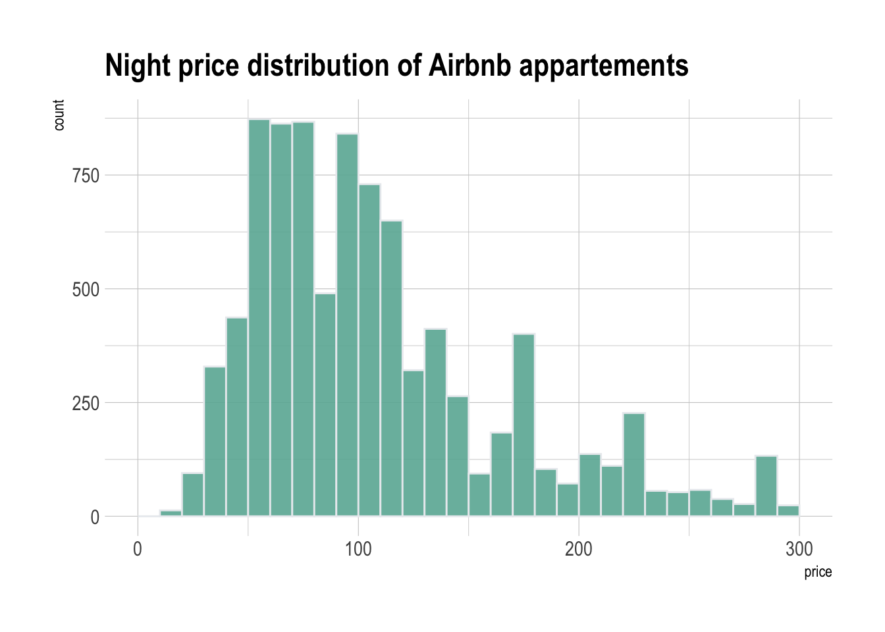
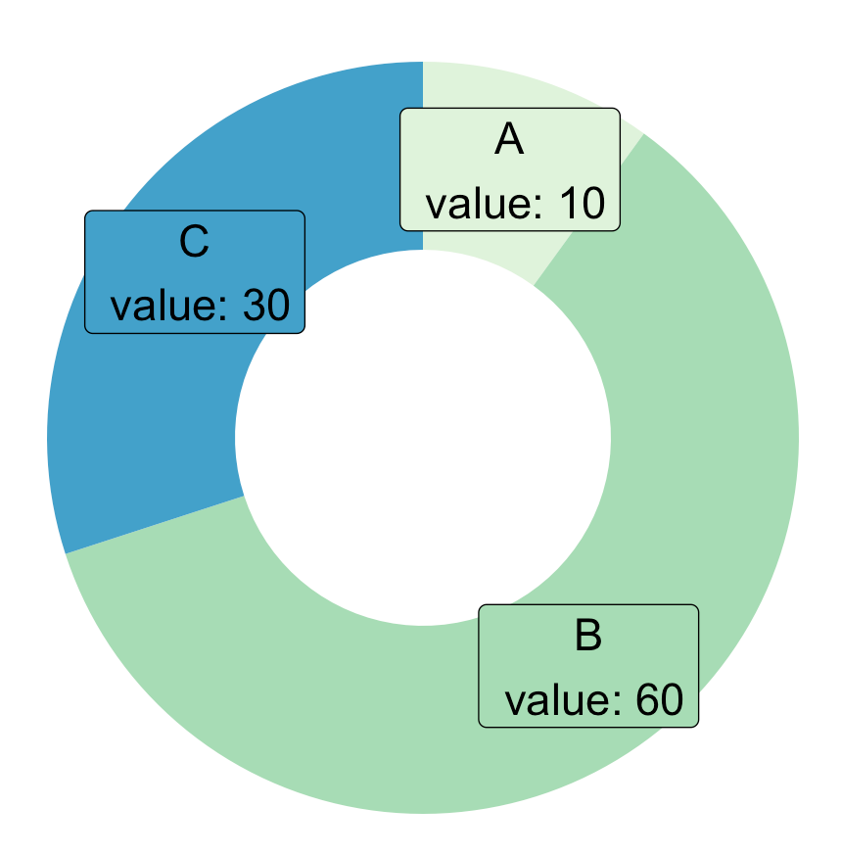
1 variable

Slide 8
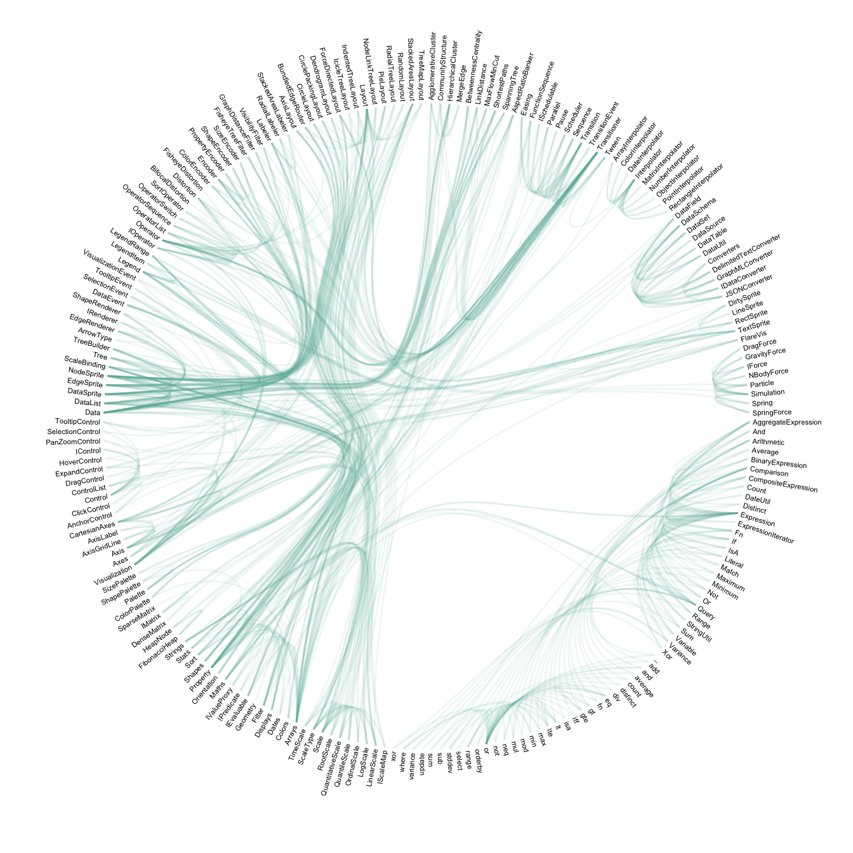
1 variable: hierarchy / graph

Slide 9
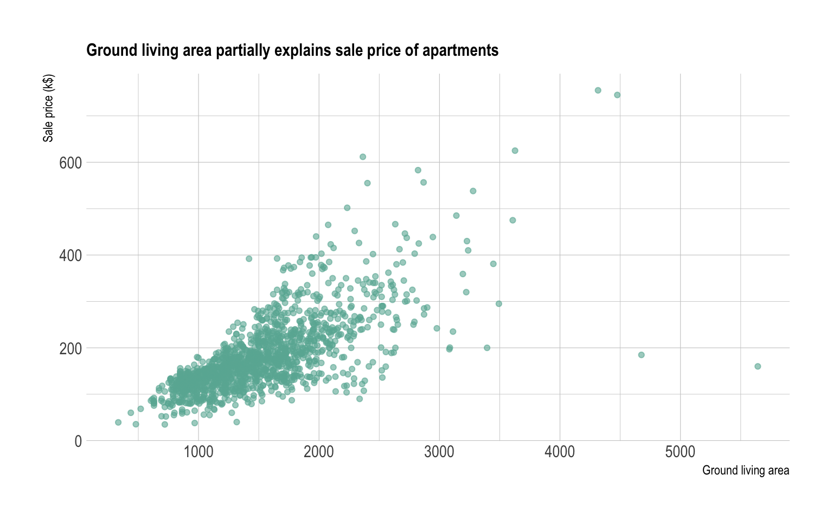
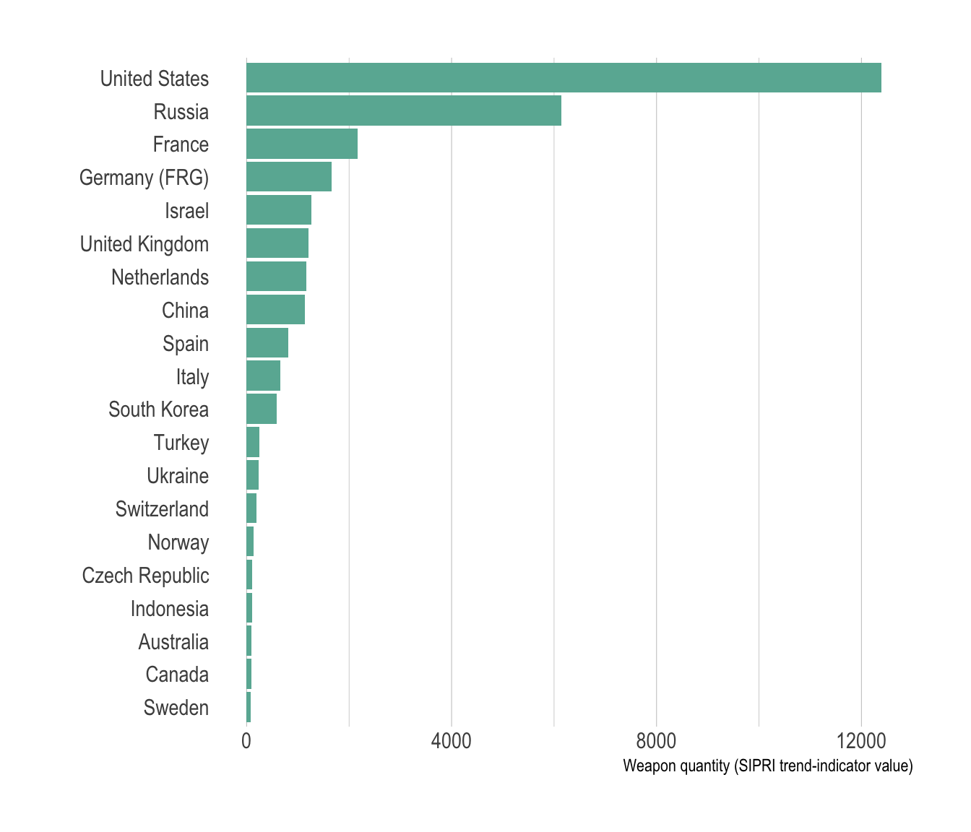
2 variable

Slide 10
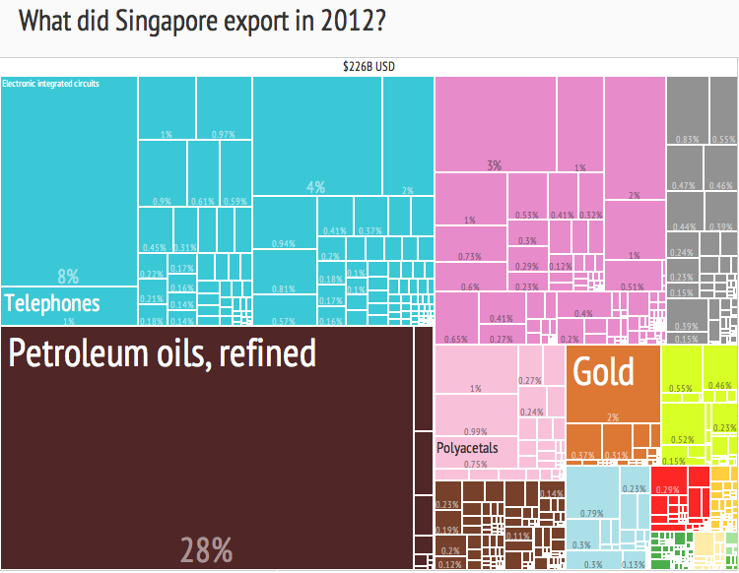
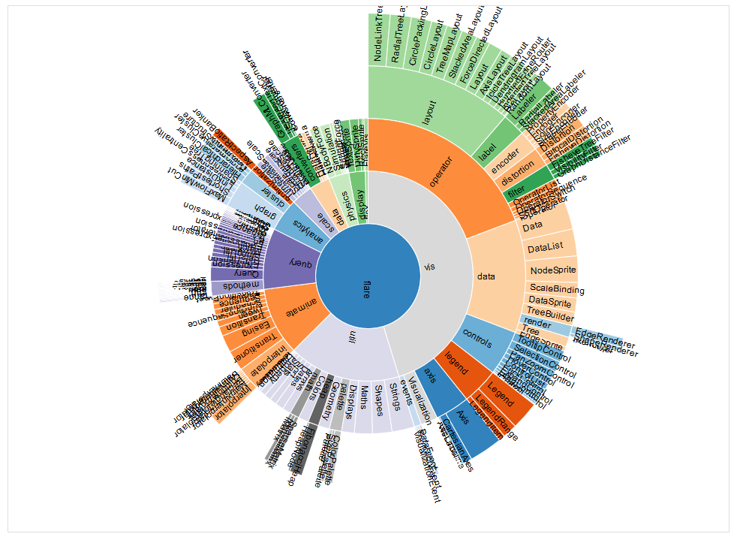
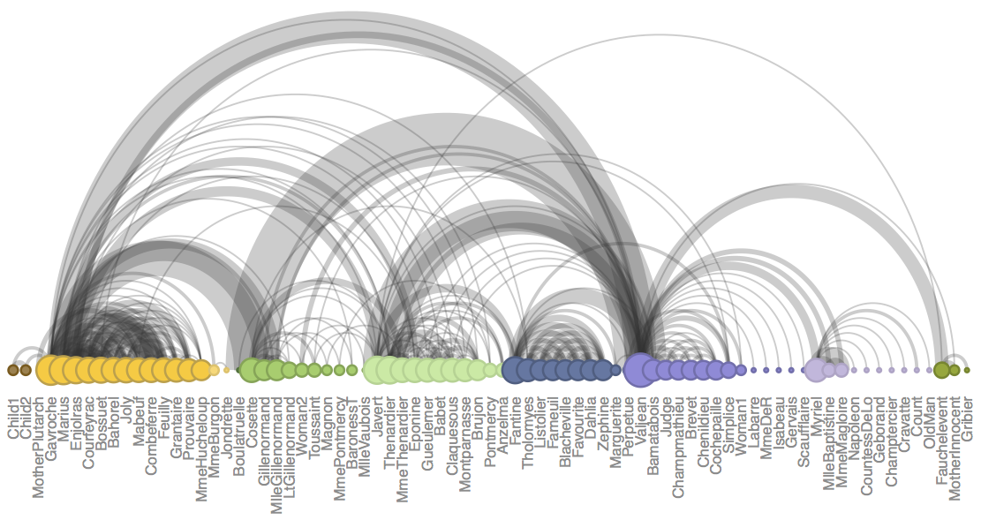
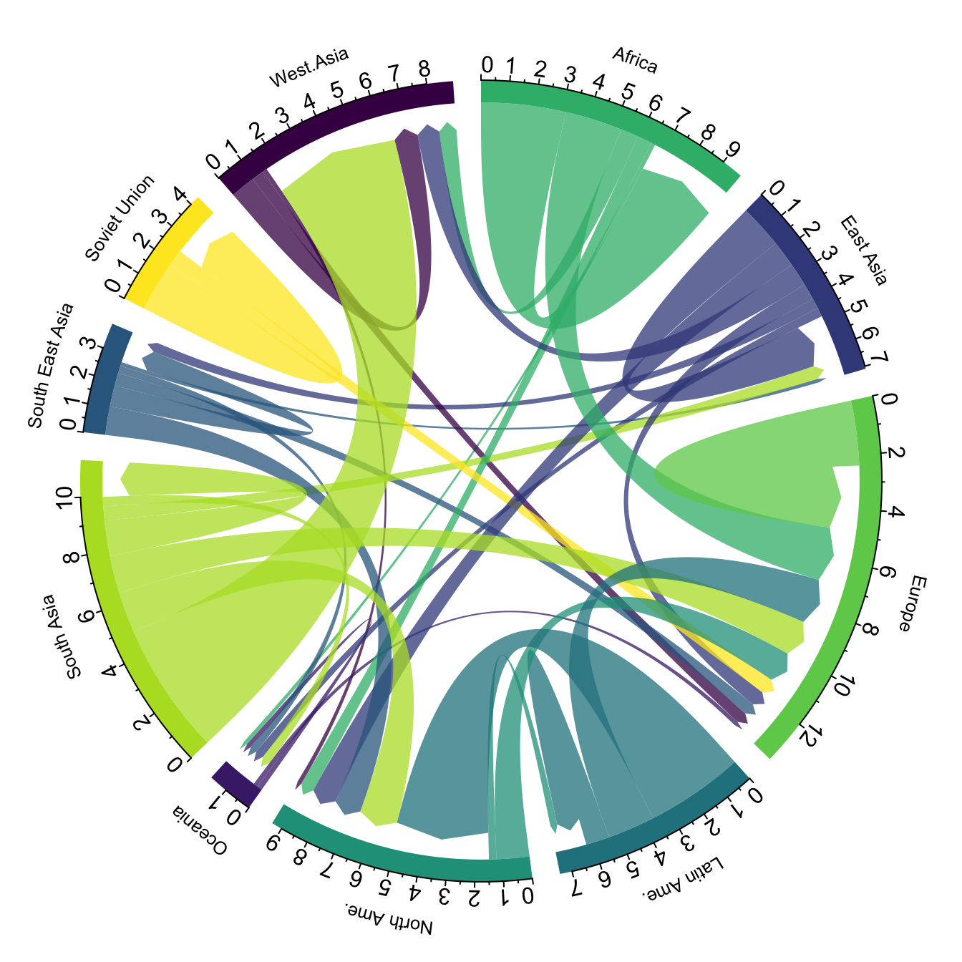
2 variables: hierarchy / graph

Slide 11
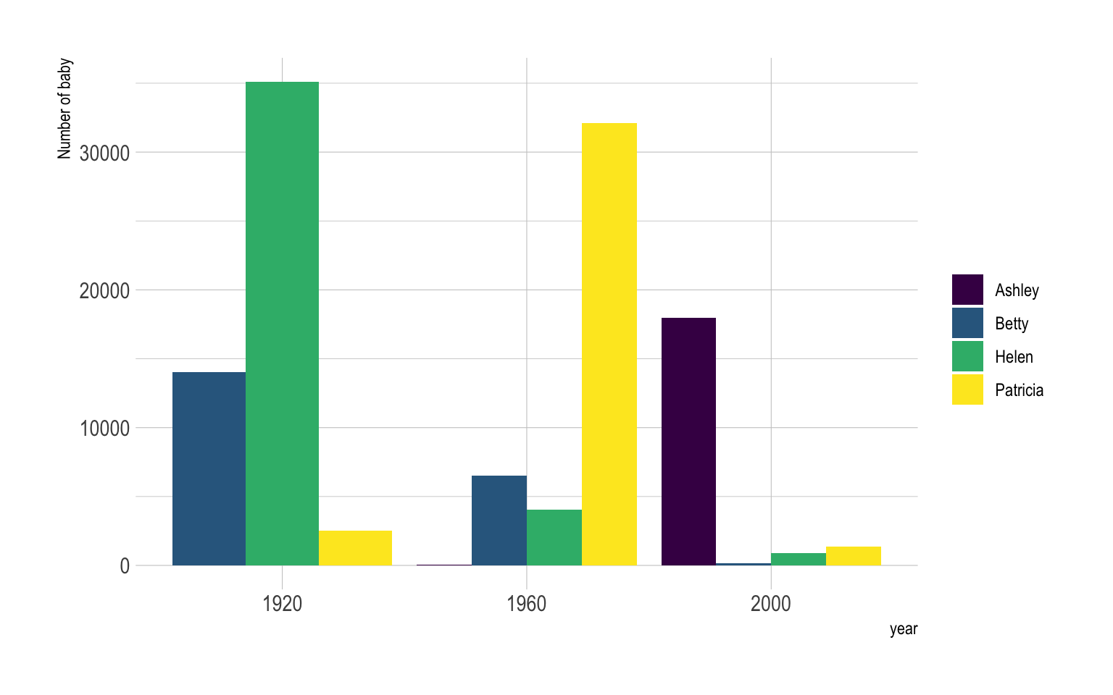
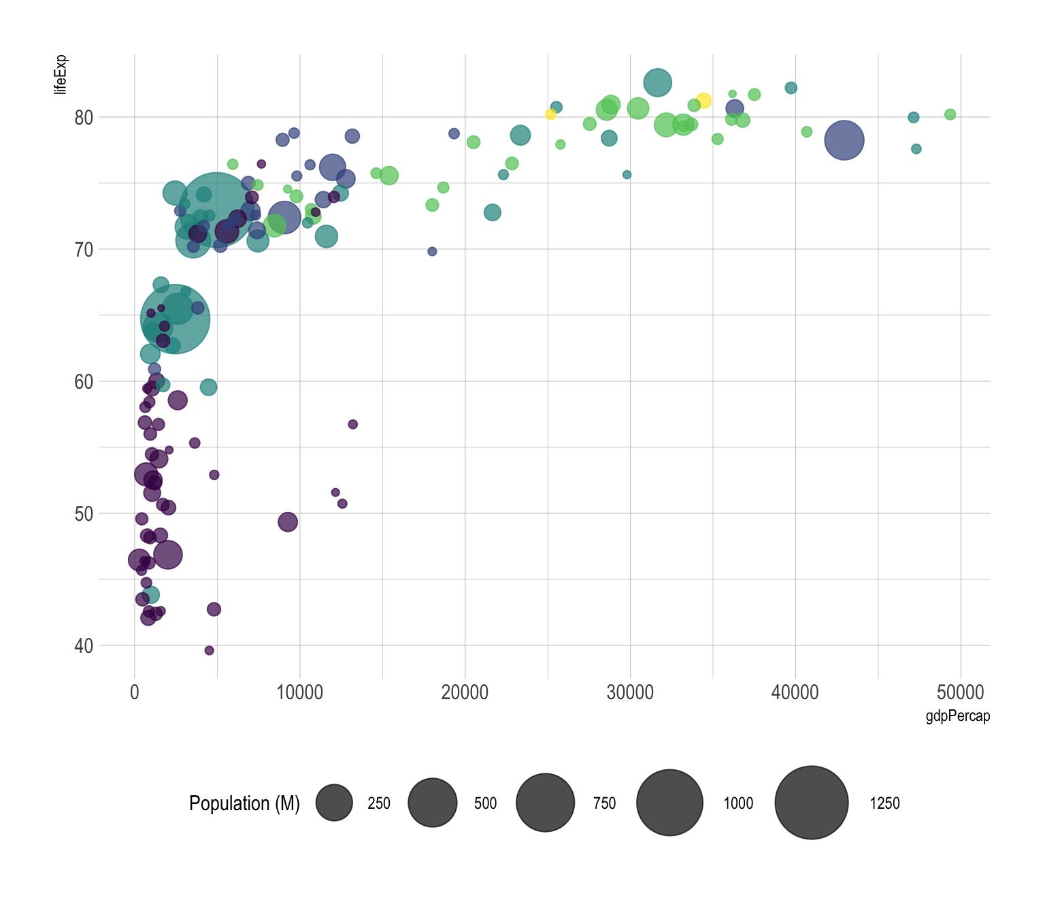
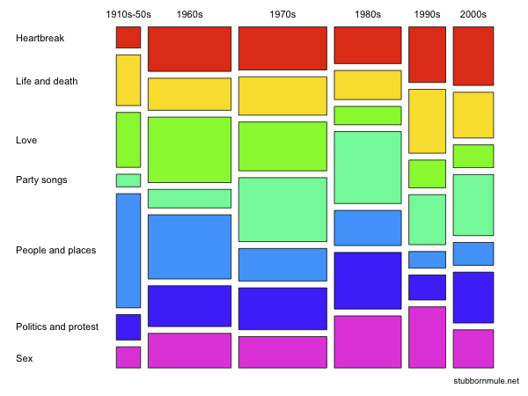
3 variable

Slide 12
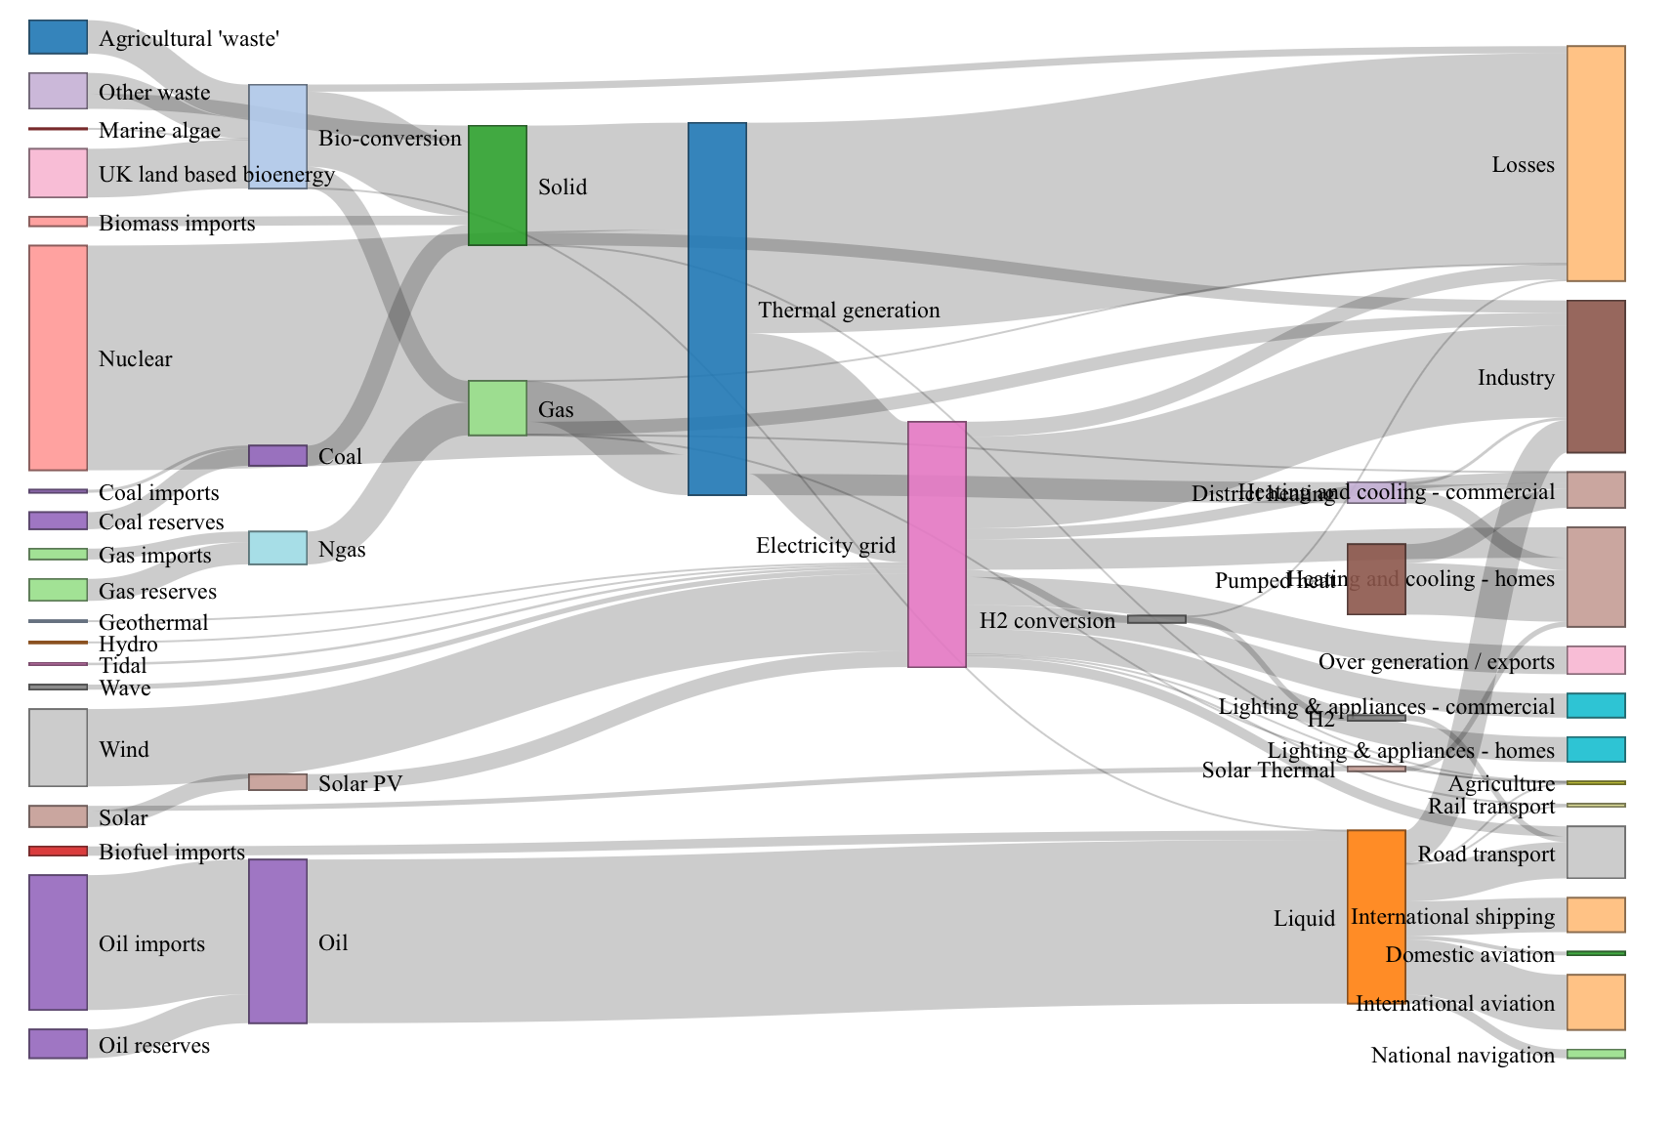
3 variable: hierarchy / graph

Slide 13
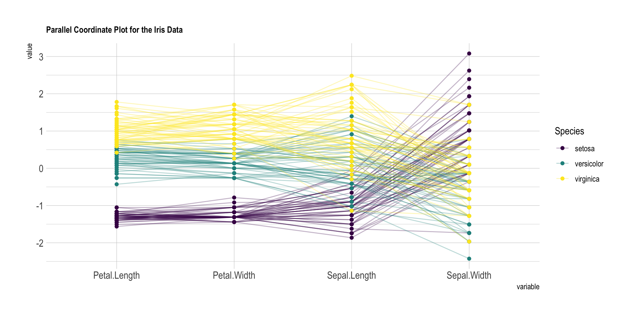
4 variable

Slide 14
The grammar is limited
Especially for higher density plots, the grammar of graphics is limited. We have to think about:
Shared / dual axes
Novel representations
Interactivity / multiple plots

Slide 15
Today
Variables: dimensions and measures.
Patterns: a sampling of options in increasing density.
> Group activity: choosing a pattern for a problem.
Tasks and domains: a look at contextualizing patterns by understanding users.

Slide 16
Example 1
Plot median income by occupation.
Dimension: Occupation
Measure: Income
Representation: Bar

Slide 17
Example 2
Plot median income by occupation and gender.

Slide 18
Example 3
Plot median income and unemployment by occupation and gender.

Slide 19
Example 4
Plot median income, unemployment, and number of people by occupation and gender.

Slide 20
Example 5
Plot median income, unemployment, and number of people by occupation, gender, and race.

Slide 21
Example 6
Plot median income, unemployment, and number of people by occupation, gender, and race in 2015 vs 2025.

Slide 22
Example 7
Plot median income, unemployment, and number of people by occupation, gender, and race each year from 2015 to 2025.

Slide 23
Today
Variables: dimensions and measures.
Patterns: a sampling of options in increasing density.
Group activity: choosing a pattern for a problem.
> Tasks and domains: a look at contextualizing patterns by understanding users.

Slide 24
Re-centering the user
Domains: Who are the users and what are the concepts of the problem area you are working in?
Tasks: What questions is the user trying to answer?

Slide 25
Re-centering the user
Plot median income, unemployment, and number of people by occupation, gender, and race each year from 2015 to 2025.
Domains: researchers - median income, overall unemployment, occupation, gender, race
Tasks: Which group had the largest gender gap by income? Which occupation saw the largest unemployment?

Slide 26
Bring stuff for drawing!
For Monday, please bring pens and paper
to do some drawing by hand.

Slide 27
Citations
Tableau, “Tableau Logo,” Salesforce, 2024. Available: https://www.salesforce.com/news/tableau-from-salesforce-logo-color-1/
H. Wickham, “Tidy Data,” Journal of Statistical Software, 2014. Available: https://www.jstatsoft.org/article/view/v059i10
Tableau, “Dimensions and Measures, Blue and Green,” Salesforce, Available: https://help.tableau.com/current/pro/desktop/en-us/datafields_typesandroles.htm
S. Carmody, “Mosaic Big,” Wikimedia Foundation, 2009. Available: https://en.wikipedia.org/wiki/Mosaic_plot#/media/File:Mosaic-big.png
G. Silvermanaz, “2012 Singapore Products Export Treemap,” Wikimedia Foundation, 2014. Available: https://en.wikipedia.org/wiki/Treemapping#/media/File:2012_Singapore_Products_Export_Treemap.png
S. Maskey, “Zoomable Sunburst with Labels Issue,” StackOverflow, 2014. Available: https://stackoverflow.com/questions/24547620/zoomable-sunburst-with-labels-issue
T. Munzner, "A Nested Model for Visualization Design and Validation," in IEEE Transactions on Visualization and Computer Graphics, vol. 15, no. 6, pp. 921-928, Nov.-Dec. 2009, doi: 10.1109/TVCG.2009.111
S. Zhang, “Canyon,” OpenProcessing. Available: https://openprocessing.org/sketch/2552991
Y. Holtz and C. Healy, “From Data to Viz,” 2018. Available: https://www.data-to-viz.com

Slide 28


